Slide 1
SMART PARKING IOT USED IN SMART PARKING

Slide 2
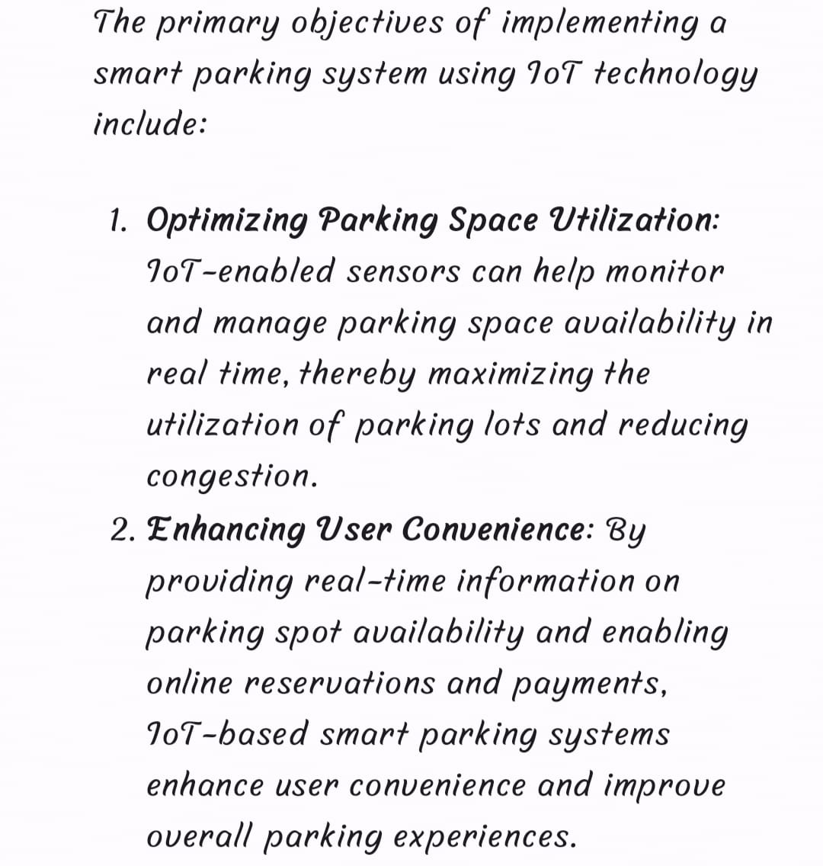
OBJECTIVES OF SMART PARKING:

Slide 3
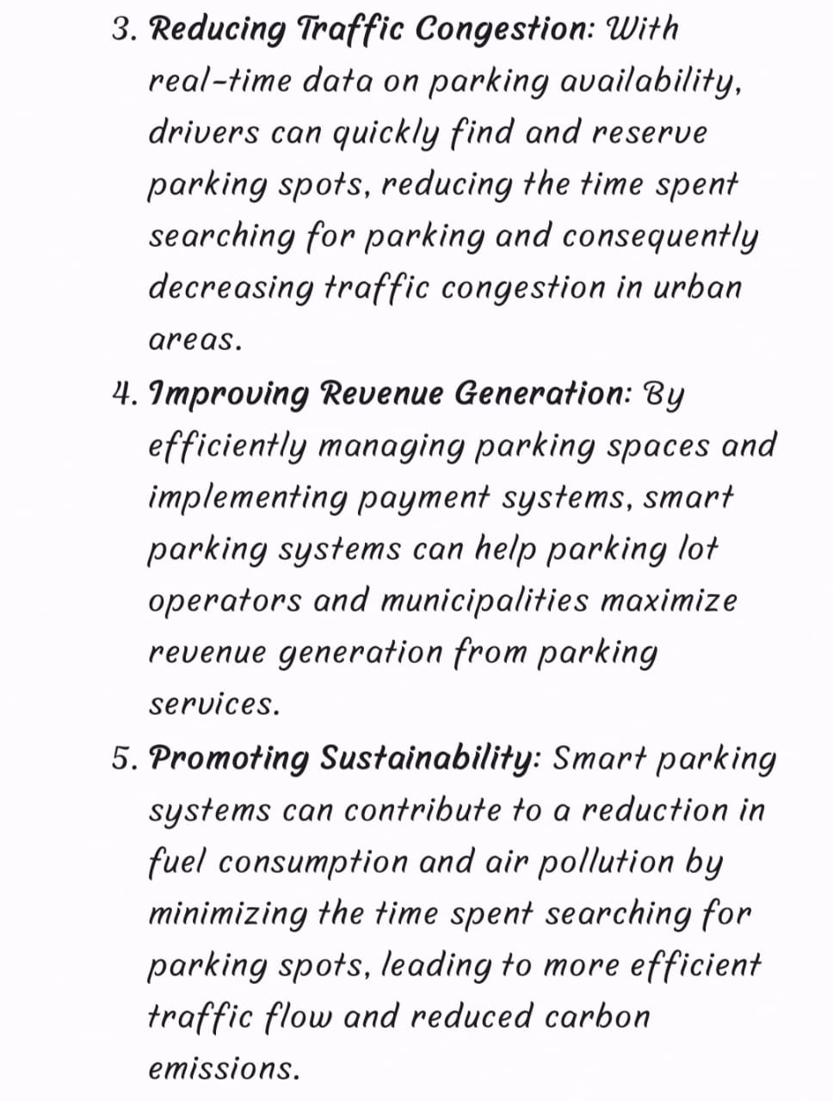

Slide 4
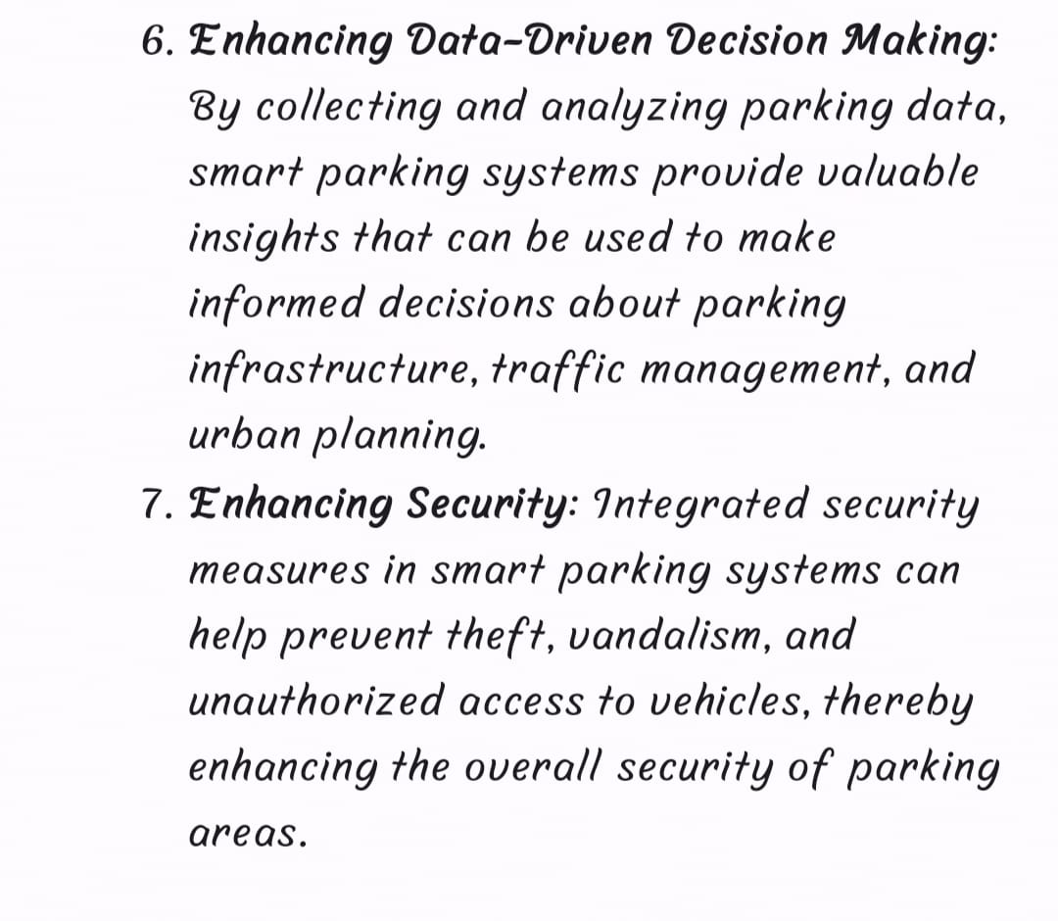

Slide 5
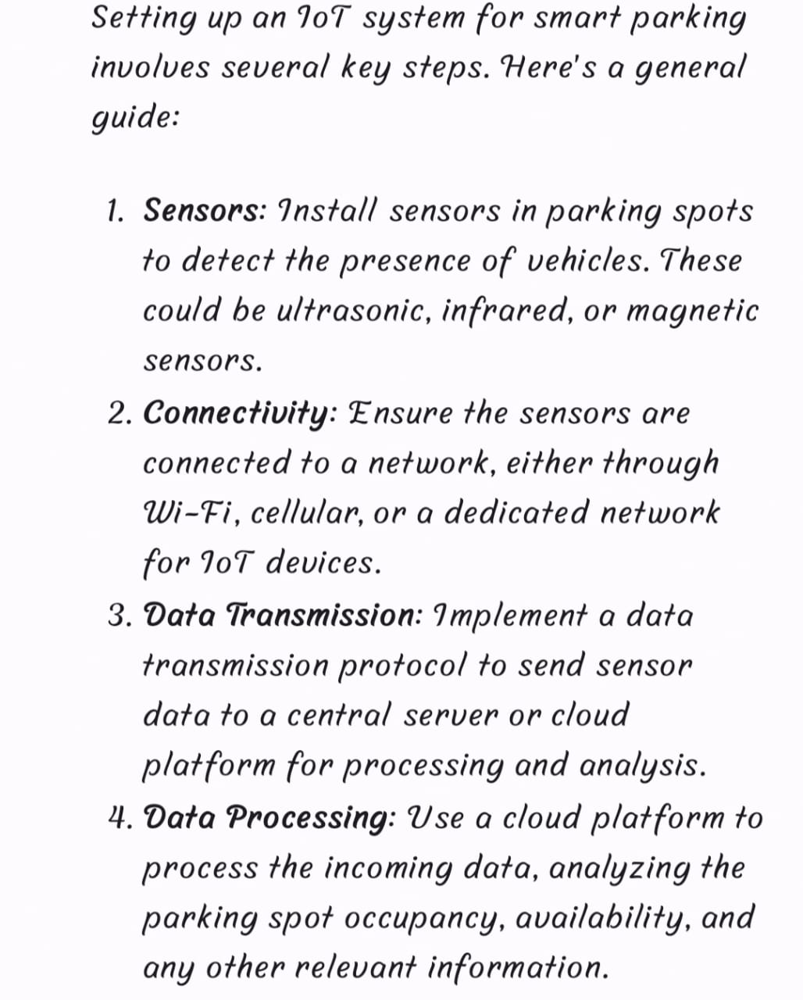
IOT DEVICE SETUP FOR SMART PARKING:

Slide 6
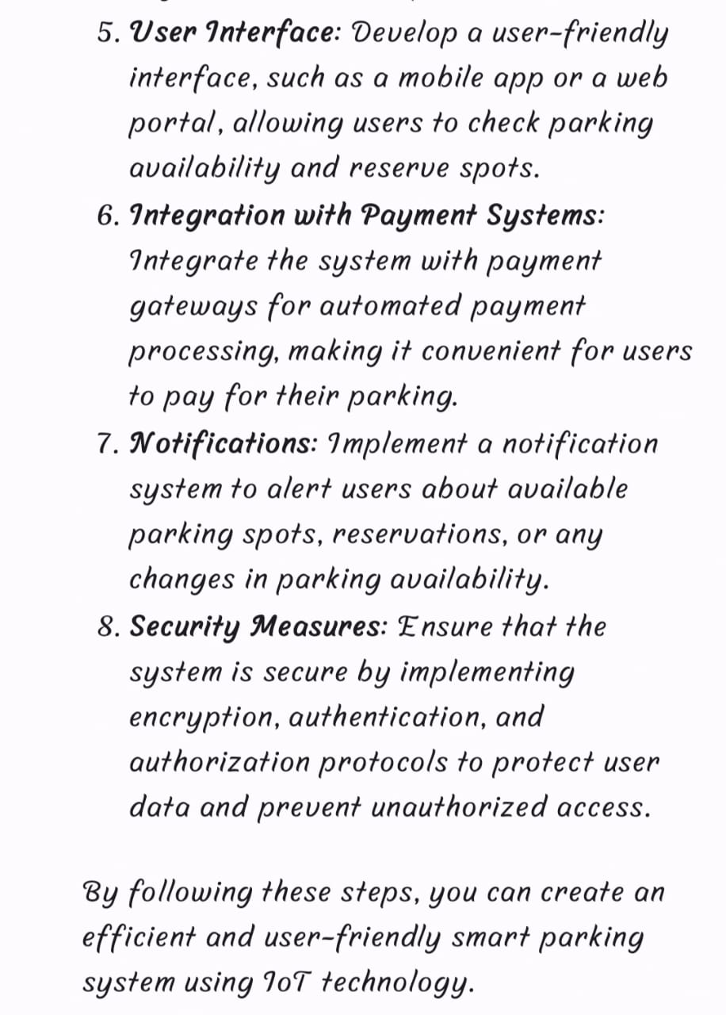

Slide 7
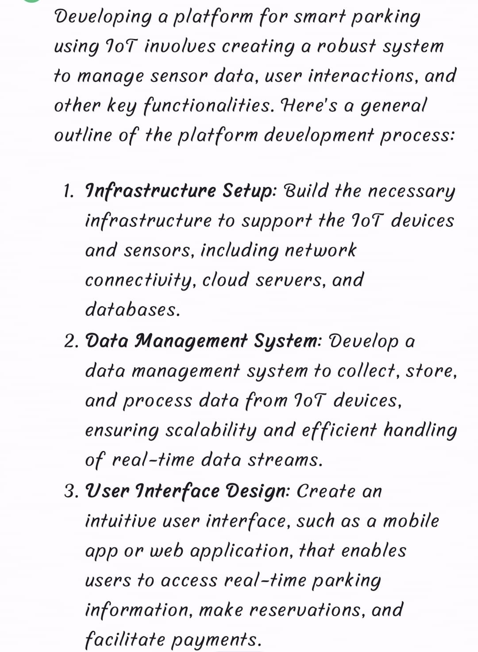
PLATFORM DEVELOPMENT FOR SMART PARKING:

Slide 8
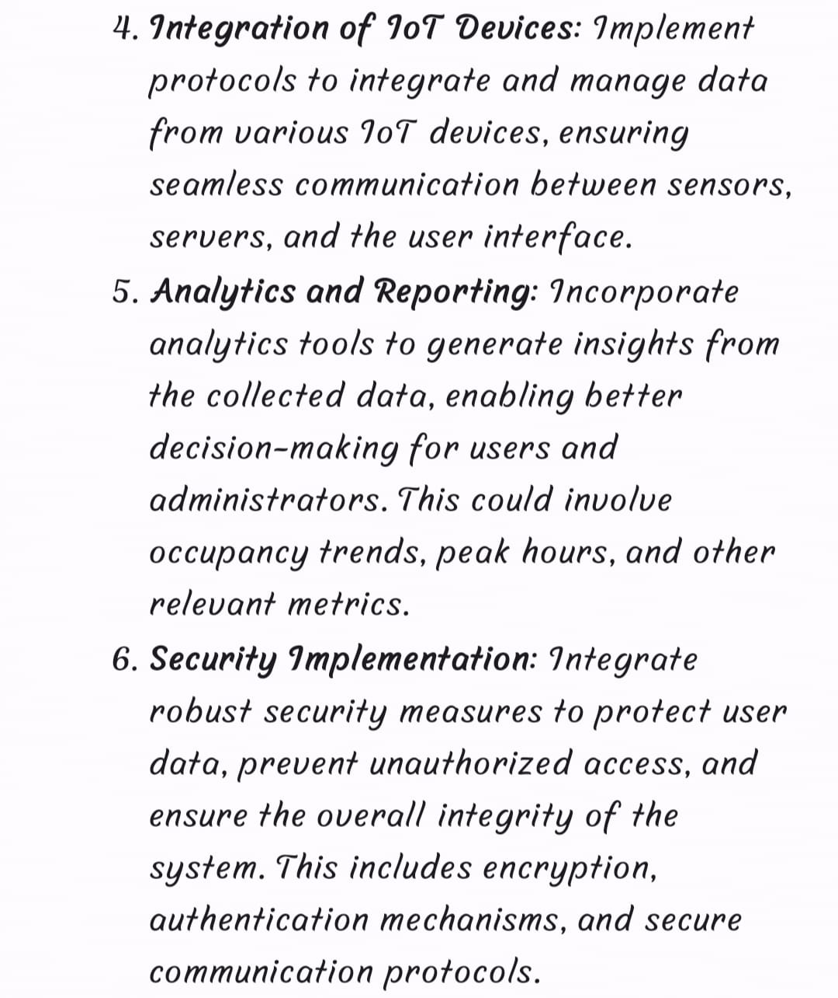

Slide 9
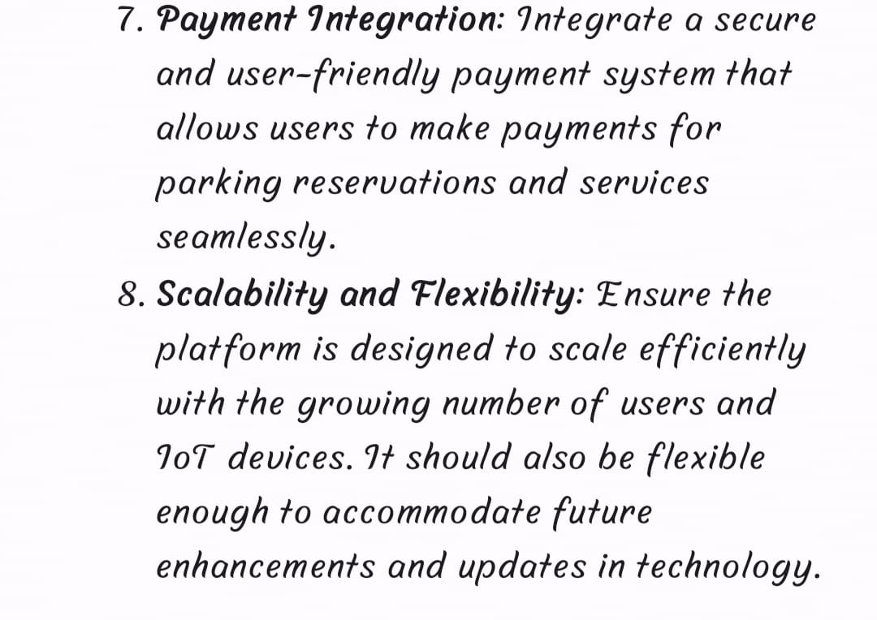

Slide 10
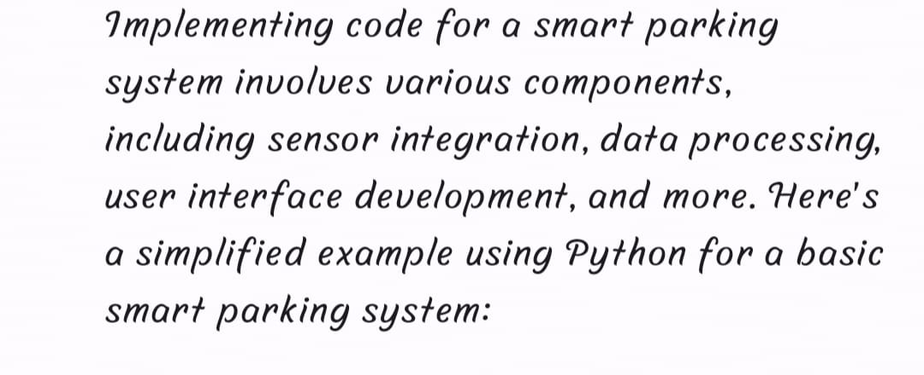
CODE IMPLEMENTATION OF SMART PARKING:

Slide 11
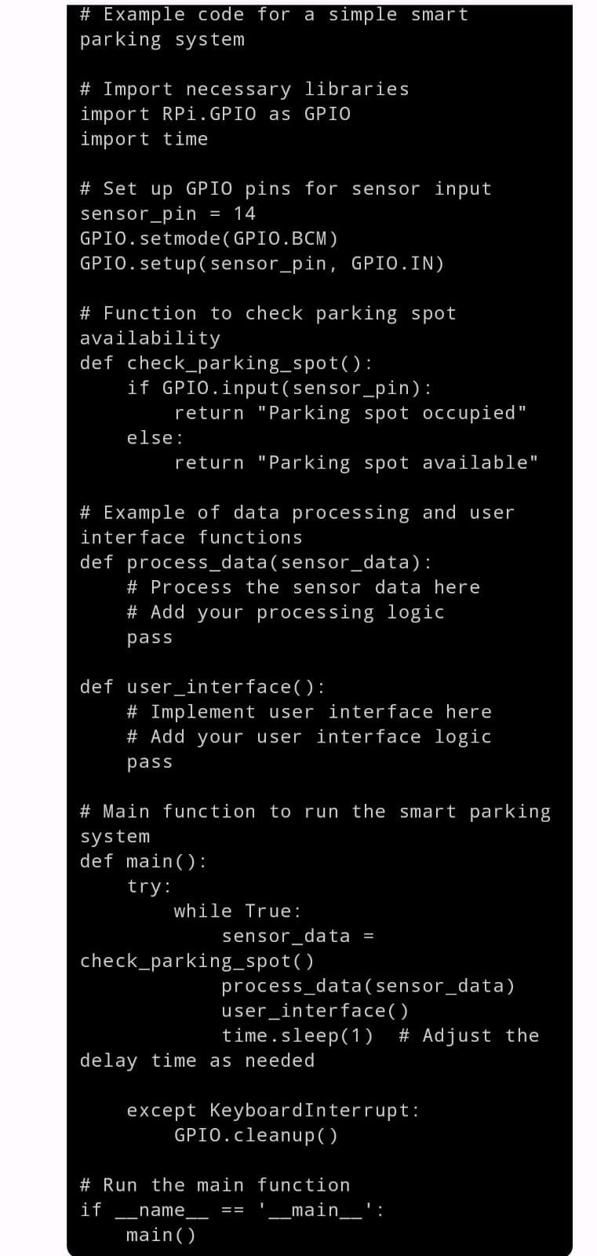

Slide 12
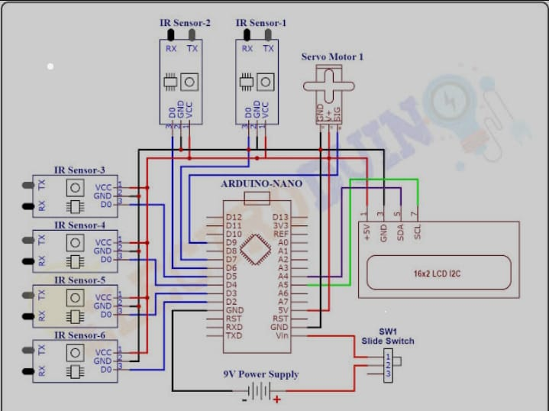

Slide 13
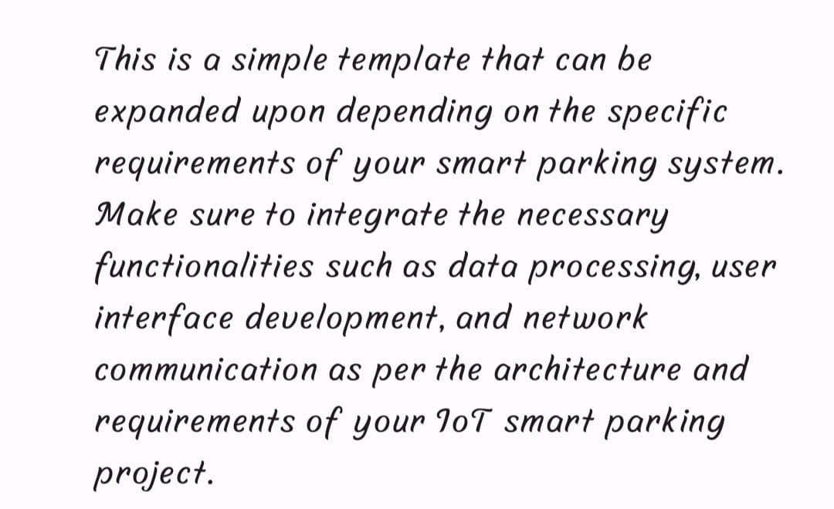

Slide 14
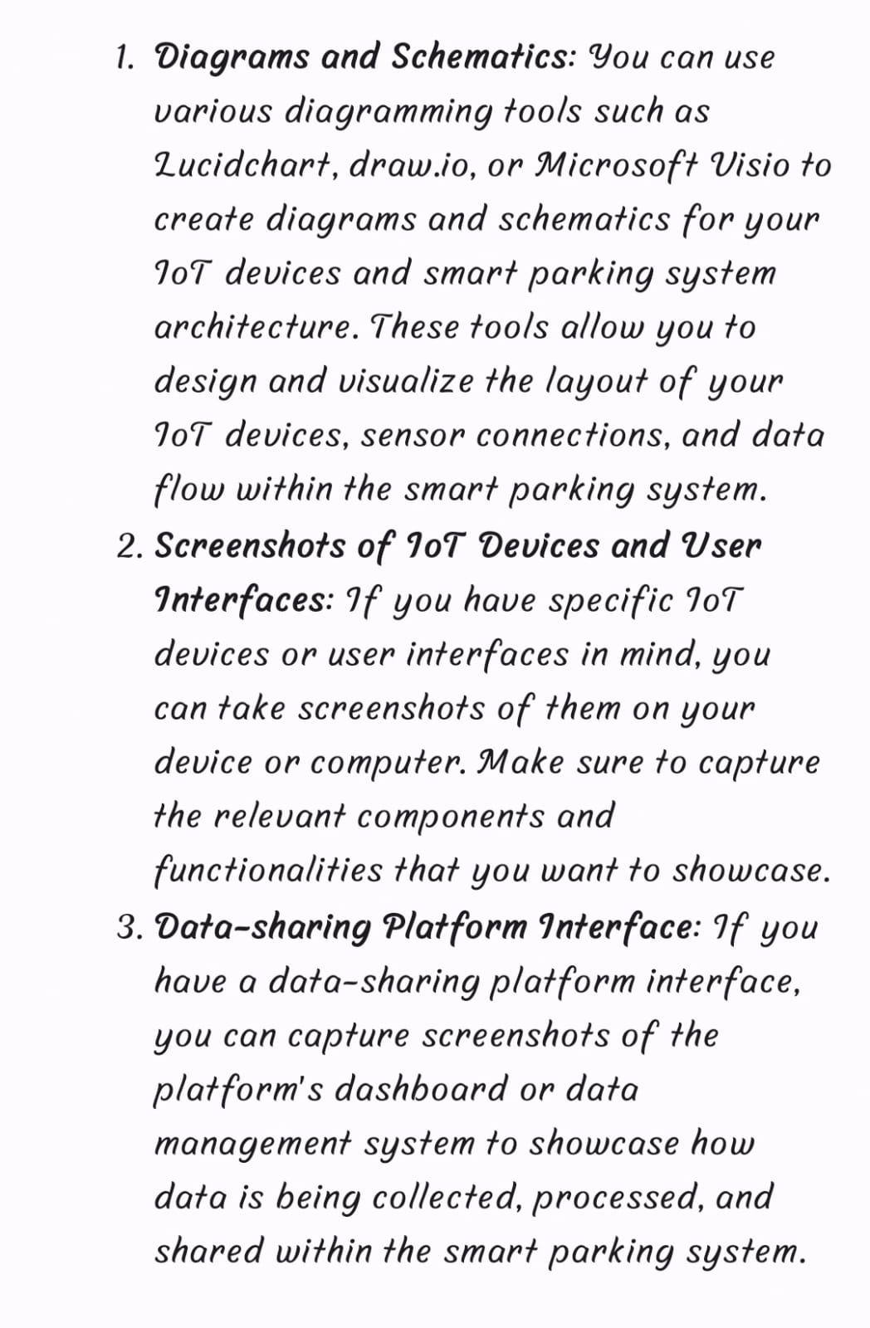

Slide 15
THANK YOU

